Slide 1
CODENAME: V-E-G
A game by Arnon, James, Mitchell

Slide 2

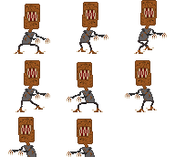
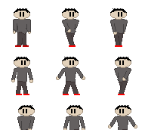
Description
STYLE: 2d platformer
A 2D platformer where the games main gameplay segment is set inside of a stereotypical American high school (see story for more details) where the main character must find the cure for the Meatloaf monsters roaming the school and confront the cafeteria lady who released them.
the levels and obstacles in the game are based around different objects that you might find in a school such as a desk, classroom, library, hall with lockers so on so forth. The game is for people who are looking to have fun and a little bit of a challenge.
The main gameplay will revolve around objective based platforming and dodging enemies which would stop us from achieving our goal.

Slide 3
STORY
A cafeteria lady driven mad by the bad comments from the students in the school, gets her revenge when she creates a genetically altering virus that turns all of the students except one into mutated meatloaf monsters! Reginald a proud vegetarian is forced to run when his friends sitting at his table are turned into meatloaf monsters, however Reginald is not affected as he did not eat the meatloaf that contained the virus! He is forced into the library when a meatloaf horde run after him, as he discovers that the librarian is also a vegetarian, he quickly learns that the answer to the cure is within the books that lay in the very library that he is standing in! While searching in the basement library he stumbles across a book called “a beginners guide to being a cafeteria lady”. Intrigued and desperate he opens the book to see if there are any hints, he finds that the book was a diary of the cafeteria lady working at the school and that she had plotted this evil catastrophe! As he reads more, he begins to understand what created the formula for these monsters, each page states the cafeteria ladies progress in creating the formula however, he got to the last 3 pages and realized that they were missing. Determined to find the last few pages he runs out of the library to collect the last few pages!

Slide 4
DIFFICULTY
The difficulty will vary as you go through the level, as you progress through the level you will experience better versions of the genetically mutated monsters which increases the difficulty, the level will also get harder because the platforms will get further apart and the approach to the platform might change.

Slide 5
REVIEWS!!!
Xxx_GamerGod_xxX
Tea_Eater_57
THIS GAME IS SO GOOD. COULDN’T STOP PLAYING IT!!!!
Nice mechanics, though a few minor bugs but still a fun game

Slide 6
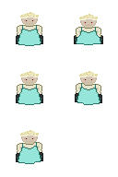
Bug Fixes
-some may experience enemies dropping from the sky (we have fixed this problem so, no one should be experiencing this anymore)
-jumping not working (we have also fixed the code for this so everyone should be jumping normally)
-invisible enemies (this was linked to the dropping enemy issue so this was quite easy to fix)

